Slide 1





Chatbot with
Dynamic Responses
Here is where your presentation begins

Slide 2



TABLE OF CONTENTS
01
INTRODUCTION
02
WHY THIS PROJECT
03
IMPLEMENTATION & CODE
04
MAINTENANCE WITH MLFLOW
05
DEPLOYMENT USING GRADIO

Slide 3


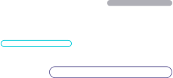
01
INTRODUCTION

Slide 4




INTRODUCTION
Generative AI and Chatbots
Generative AI is a technology that allows machines to create new content, such as text or images, by learning from large datasets. In chatbots, generative AI enables the system to respond to user inputs with natural, human-like answers.
Unlike traditional chatbots that rely on predefined responses, generative chatbots use models like GPT (Generative Pre-trained Transformer) to generate dynamic and context-aware conversations.

Slide 5




MAIN IDEAS OF THE PROJECT
In this project, we build a generative chatbot using GPT-2. By training the model on conversational data, the chatbot can understand input and generate meaningful responses. This approach improves user interaction, making chatbots more flexible and intelligent for applications like customer service and virtual assistants.

Slide 6
02
WHY THIS PROJECT

Slide 7



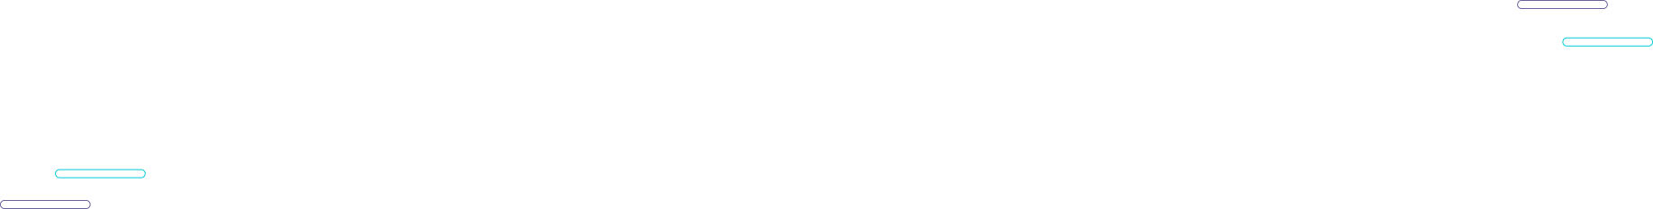
WHY THIS PROJECT
IMPROVING CONTEXTUAL UNDERSTANDING
GPT-2, a transformer-based language model, can generate contextually relevant responses by learning from large datasets. This allows the chatbot to maintain conversation flow and produce coherent, human-like answers.
DYNAMIC RESPONCE GENERATION
Instead of relying on static responses, the model generates new text based on input, making interactions more versatile and adaptable to various conversational scenarios. Techniques like top-k sampling and temperature control are applied to introduce response diversity.

Slide 8
WHY THIS PROJECT
SCALABILITY AND ADAPTABILITY
By fine-tuning a pre-trained model, this project demonstrates how transfer learning can be utilized to adapt AI models for domain-specific applications. This reduces training time and computational resources compared to training models from scratch.
EFFICIENCY WITH PRE-TRAINED MODELS
Using pre-trained models like GPT-2 accelerates development and leverages the general understanding of language captured by the model. Fine-tuning allows customization for specific use cases without needing to retrain the entire model.

Slide 9
WHY THIS PROJECT
COMMUNICATION
This project aims to create an intelligent chatbot using generative AI to improve the way machines communicate with humans.
FLEXIBILITY
By leveraging a powerful language model like GPT-2, this project allows the chatbot to generate more flexible, context-aware answers, making interactions smoother and more human-like.

Slide 10
WHY THIS PROJECT
THIS WASN’T THE FIRST
We have worked on another project (TEXT TO IMAGE) generation, which explores how AI can generate images based on text descriptions. However, this project is currently incomplete due to resource limitations, as it requires extensive computational power and multiple GPUs for efficient execution
THIS MADE US A CALLENGE

Slide 11
03
IMPLEMENTATION &CODE

Slide 12


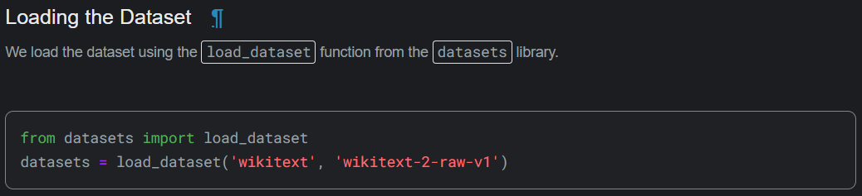


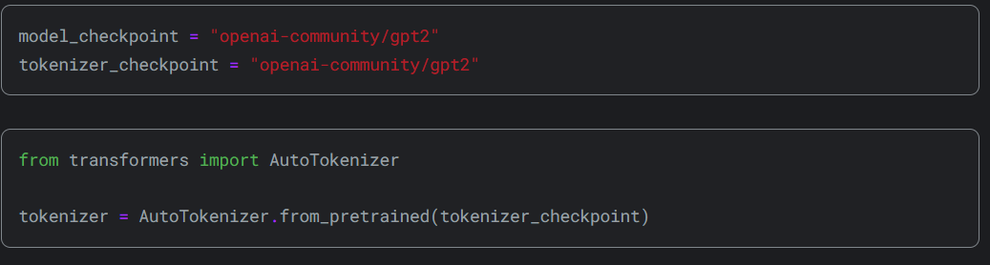
LOADING THE DATASET
LOADING THE MODEL & TOKENIZER

Slide 13
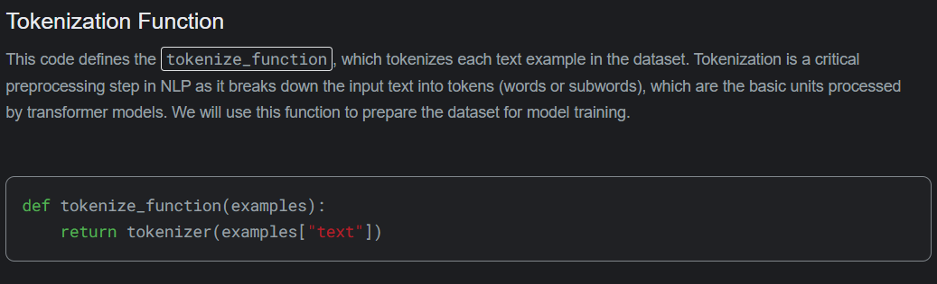
TOKENIZATION FUNCTION

Slide 14
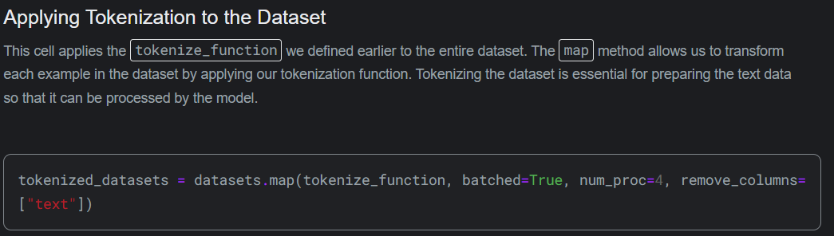
APPLYING TOKENIZATION

Slide 15
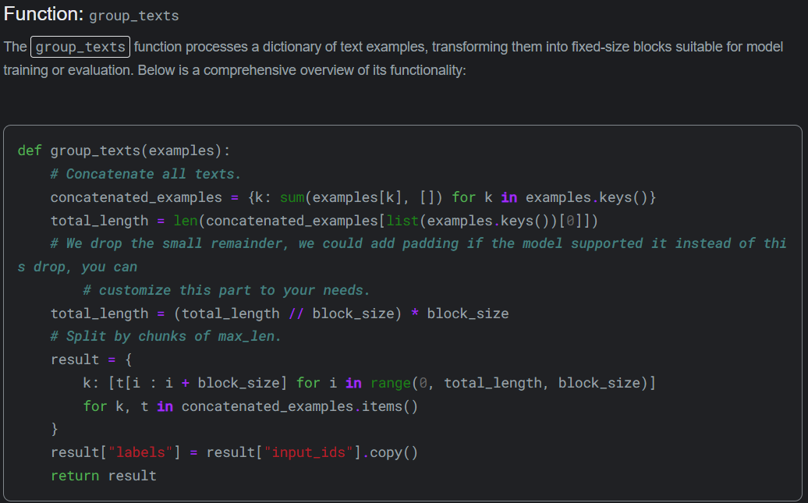
GROUPING TEXT

Slide 16
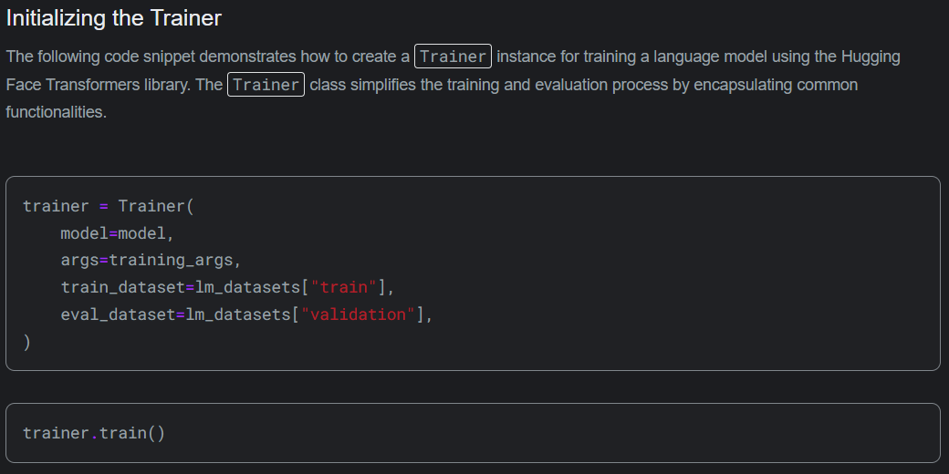
INITIALIZING THE TRAINER

Slide 17
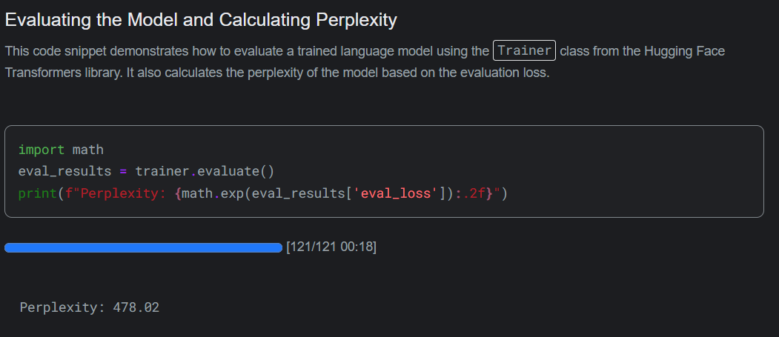
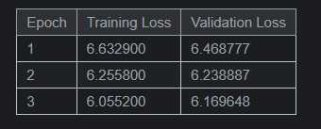
EVALUATING THE MODEL

Slide 18
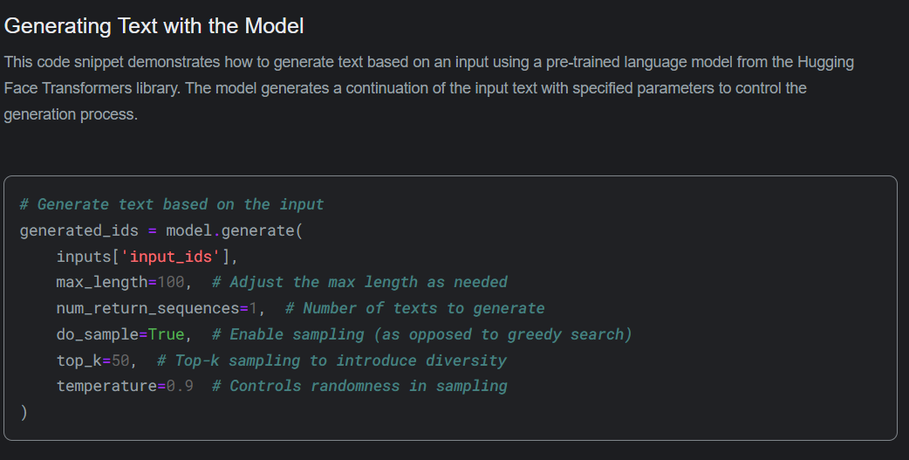
GENERATE TEXT WITH MODEL

Slide 19
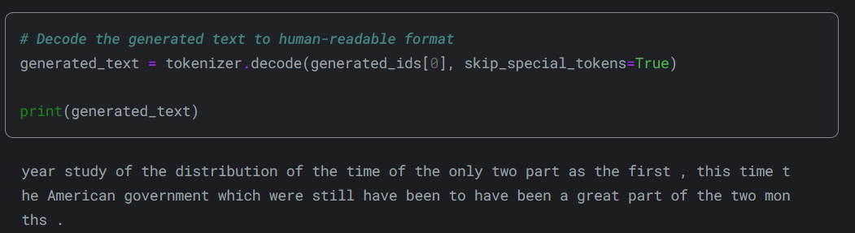
DECODE THE GENERATED TEXT

Slide 20
04
MAINTENANCE WITH MLFLOW

Slide 21
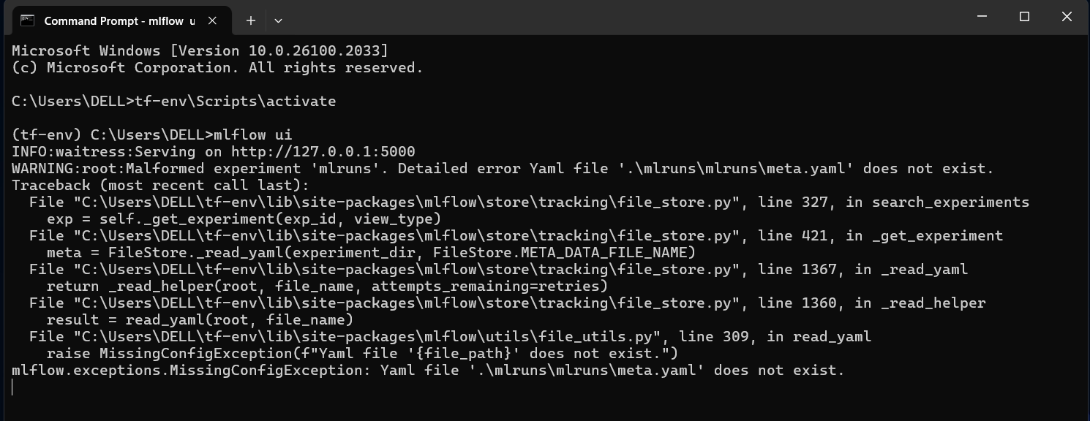
ACTIVATING MLFLOW UI

Slide 22
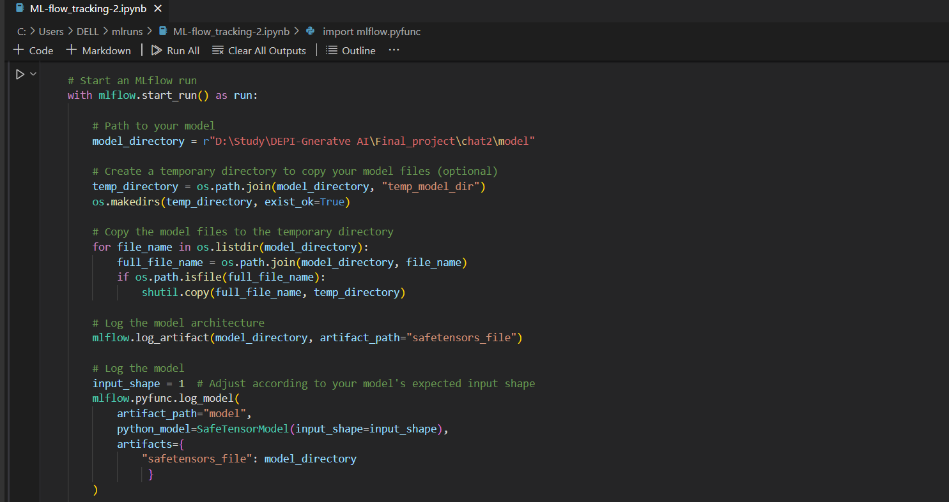
START MLFLOW RUN

Slide 23
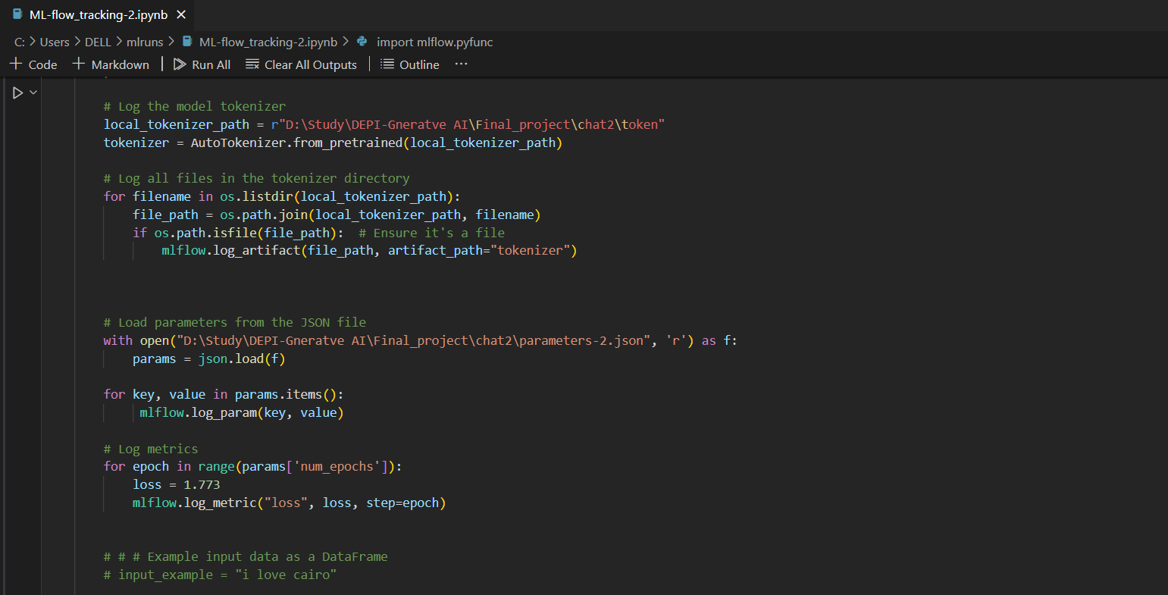
START MLFLOW RUN

Slide 24
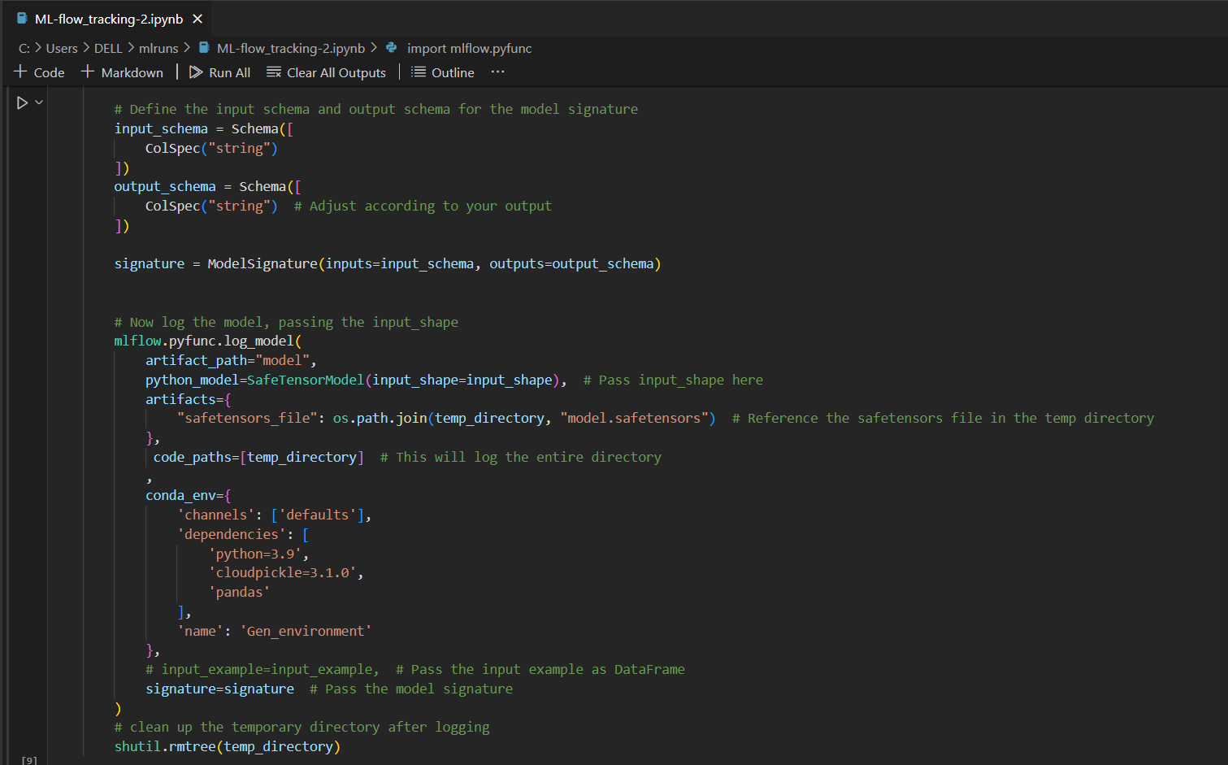
START MLFLOW RUN

Slide 25
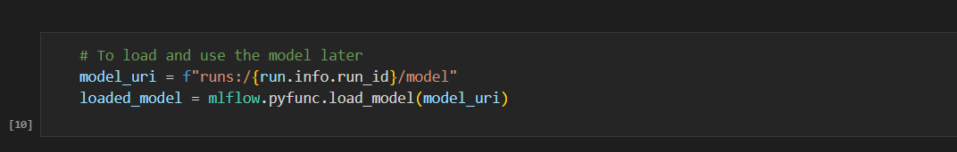
START MLFLOW RUN

Slide 26
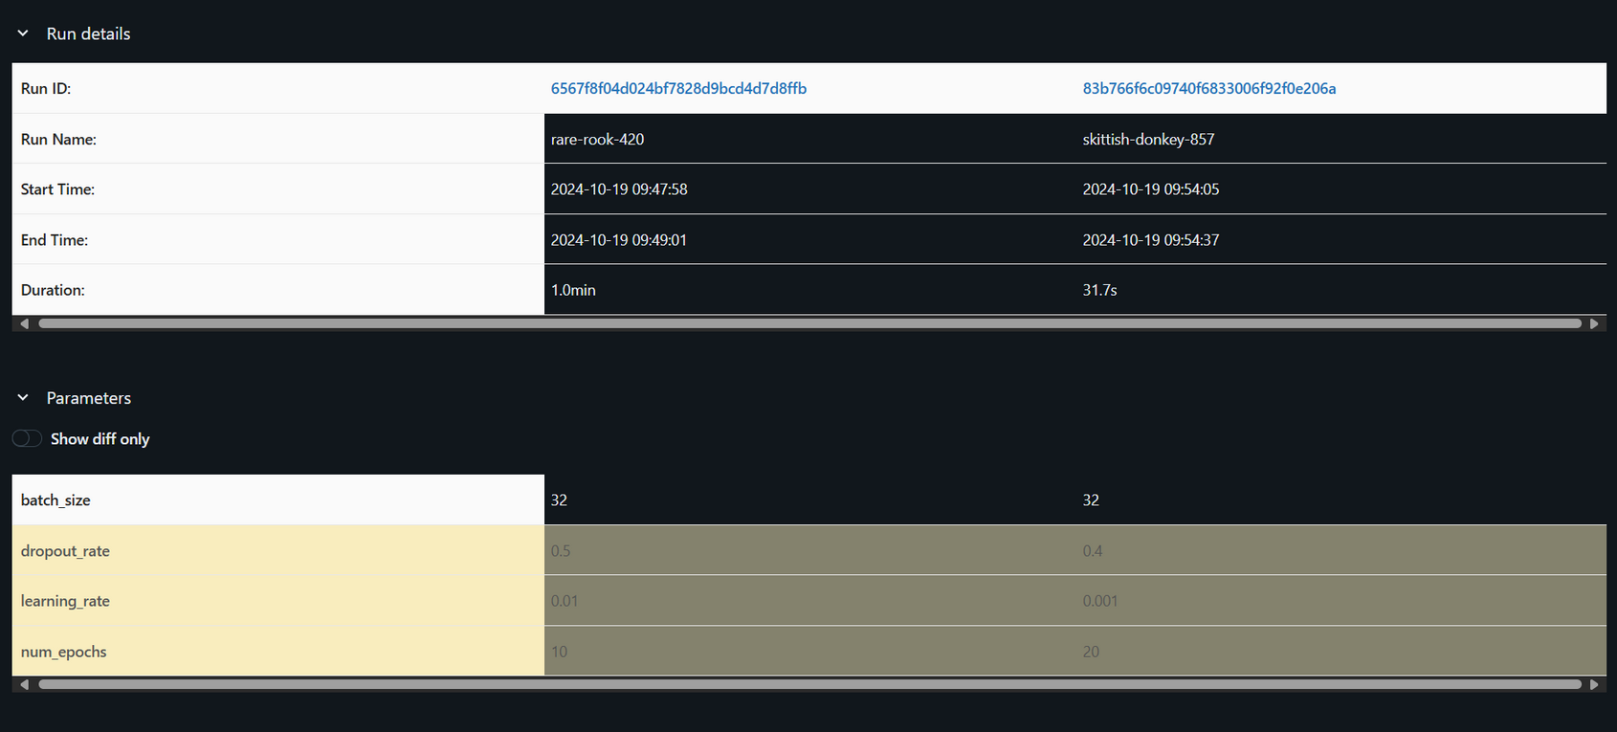
MONITORING RUNS

Slide 27
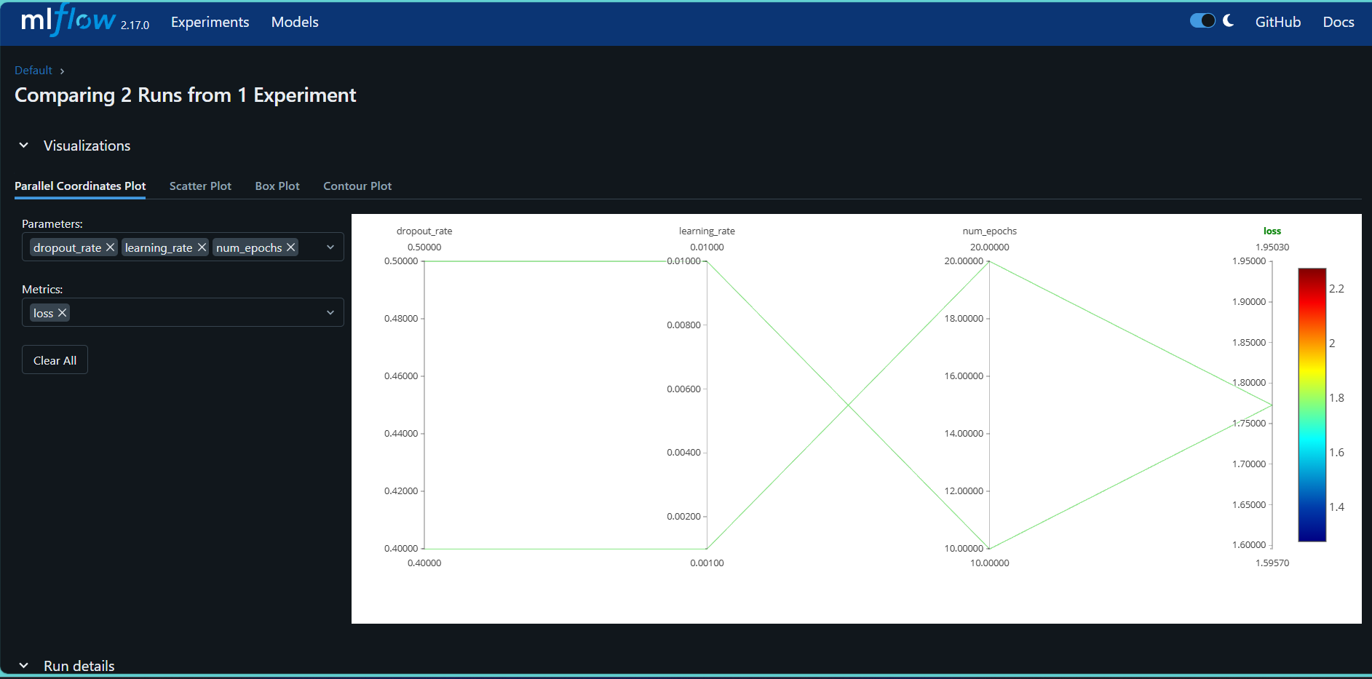
COMPARING 2 RUNS

Slide 28
05
DEPLYMENT USING HUGGINGFACE

Slide 29
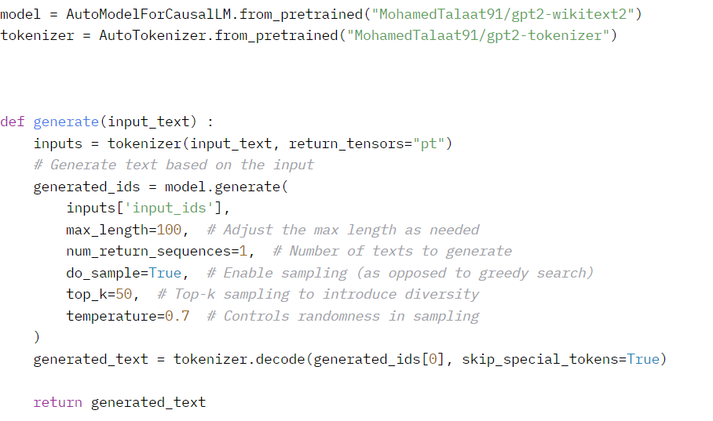
CREATING A FUNCTION TO GENERATE TEXT

Slide 30
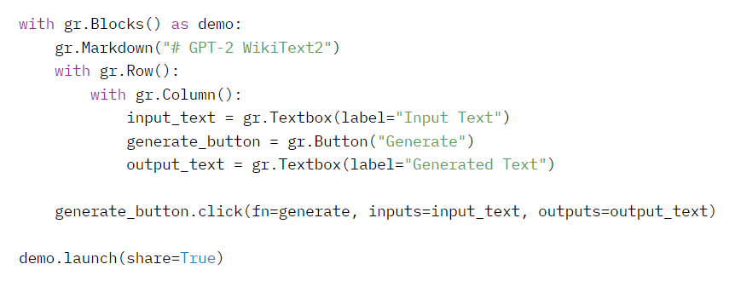
CREATING A UI BLOCK WITH GRADIO

Slide 31
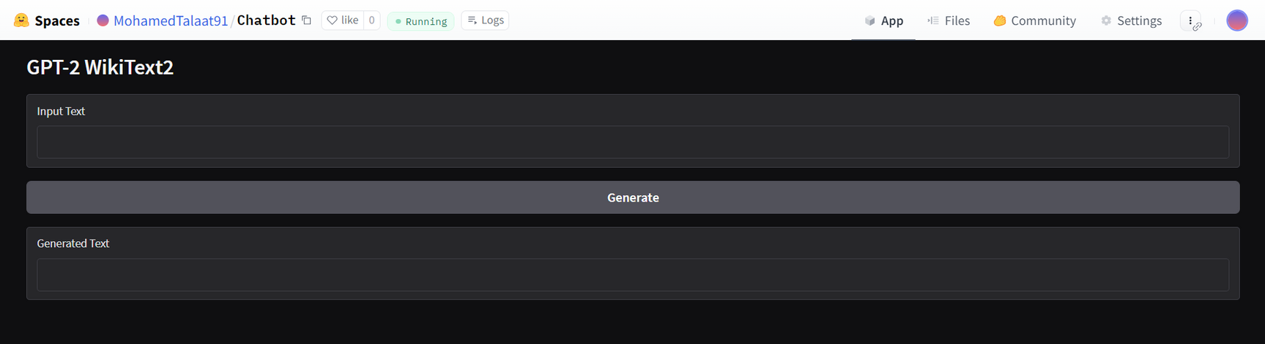
CREATING A UI BLOCK WITH GRADIO

Slide 32



THANKS!

